Slide 1
Genetic Algorithm Lec 4

Slide 2
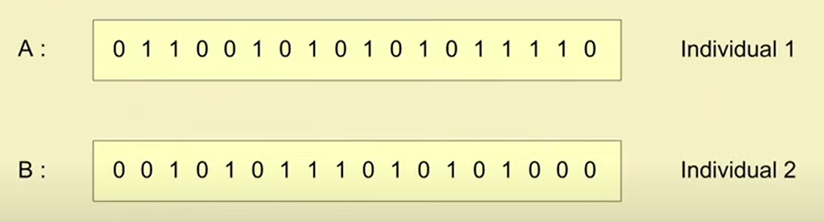
Binary Encoding
In this scheme, a gene (and hence, a chromosome) is represented by a string of 0s and 1s.
The chromosome length is fixed for SGA and SSGA, and variable for Messy GA

Slide 3
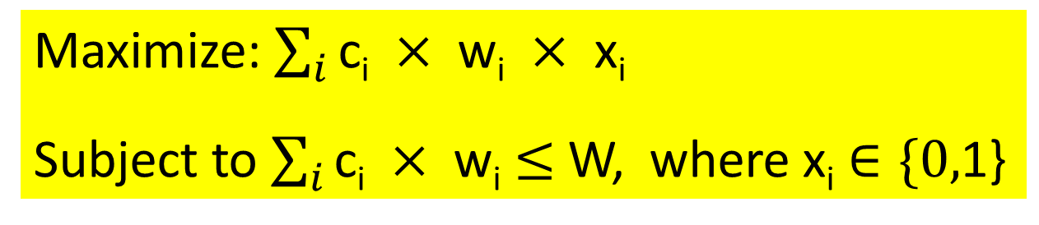
Example: 0-1 Knapsack Problem
There are n items: i^{th} item has its own cost c_{i} and weight w_{i}.
There is a knapsack of total capacity W.
The problem is to take item with maximum value without exceeding the capacity of knapsack.
Formulate the optimization problem:
Maximize: $\sum_{i}{\text{c}\text{i} × \text{wi} × \text{xi}}$
Subject to $\sum_{i}{\text{c}\text{i} × \text{wi}}$ $≤$ W, where $\text{x}\text{i}$ $∈\{0,$1}

Slide 4
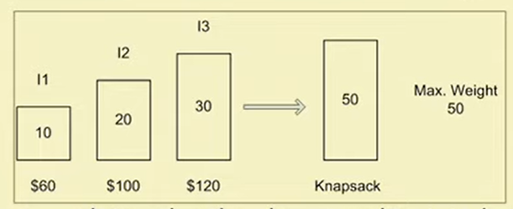
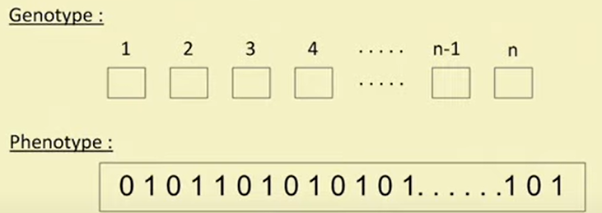
Example: 0-1 Knapsack Problem
Brut-force approach to solve the above is as follows:
We can either select an item or not select an item. Total no. of possibilities is 2^{n}-1
[10], [20], [30], [10,20], [10,30], [20,30], [10,20,30]
Possible binary encoding for the given problem: 1 for selecting, 0 for not selecting
[000], [001], [010], [011], [100], [101], [110], [111]
The encoding of the 0-1 Knapsack Problem for n items would look like:

Slide 5
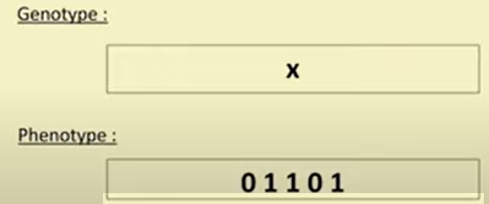
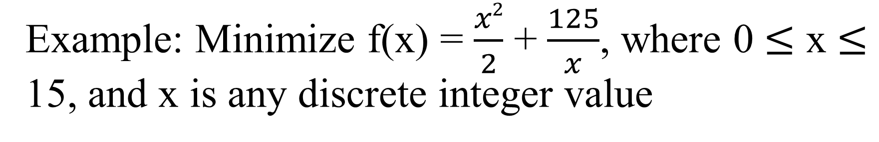
Example: Minimize f(x) = $\frac{x2}{2}$ + $\frac{125}{x}$, where 0 $≤$ x $≤$ 15, and x is any discrete integer value
Encoding: A binary string of 5 bits

Slide 6
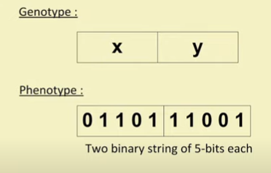
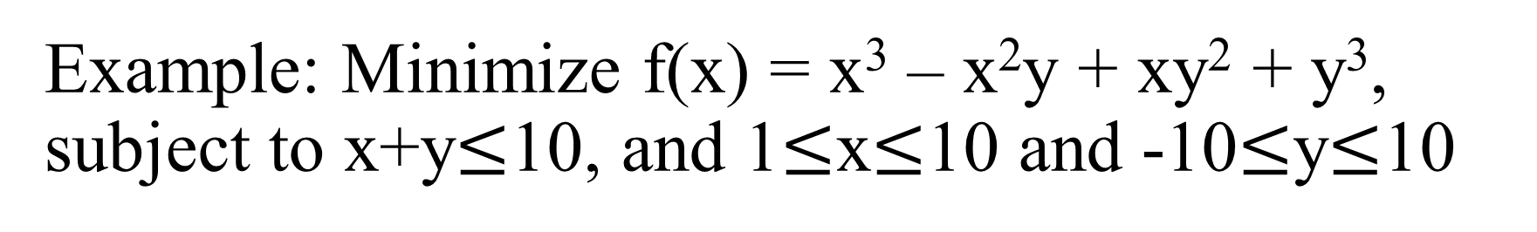
Example: Minimize f(x) = x³ – x²y + xy² + y³, subject to x+y$≤$10, and 1$≤$x$≤$10 and -10$≤$y$≤$10
Encoding: A binary string of 10 bits, 5 bits for each of x and y

Slide 7
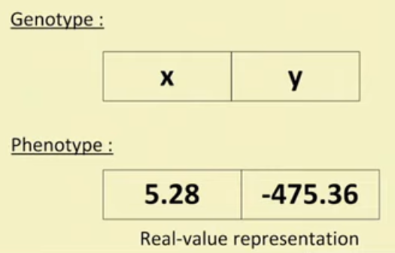
Real-Value Encoding
The real-coded GA is most suitable for optimization in a continuous search space
Use the direct representations of the design parameters
Avoids any intermediate encoding and decoding steps

Slide 8
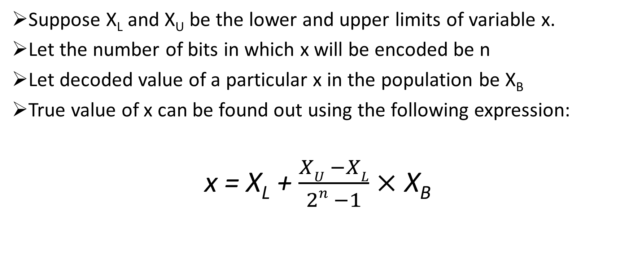
Real-Value Encoding with Binary Codes
Suppose X_{L} and X_{U} be the lower and upper limits of variable x.
Let the number of bits in which x will be encoded be n
Let decoded value of a particular x in the population be X_{B}
True value of x can be found out using the following expression:
x = X_{L} + $\frac{XU −XL}{2n −1}$ $×$ X_{B}

Slide 9
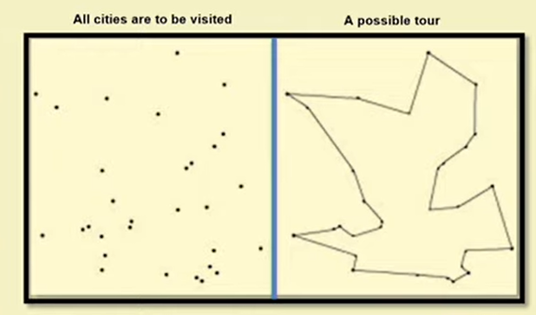
Order Encoding
Let us have a look into the following instance of the Travelling Salesman Problem
Visit all cities
Visit one city only once
Return back to the starting city

Slide 10
Order Encoding for TSP
Understanding the TSP: There is a cost of visiting one city from another city, and hence the total cost of visiting all cities must be minimized. This cost may be considered to be the total distance travelled by the salesman.
Objective Function: Find a tour (i.e., a cycle covering all cities) with minimum cost
Constraints: (i) All cities must be visited, (ii) There will be only one occurrence of each city except the starting city
We have to find the best path out of n! possible paths

Slide 11
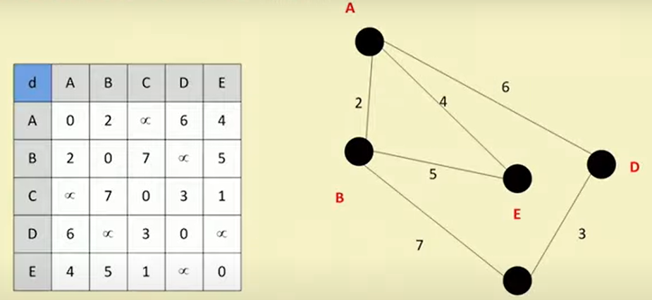
TSP Example
C

Slide 12
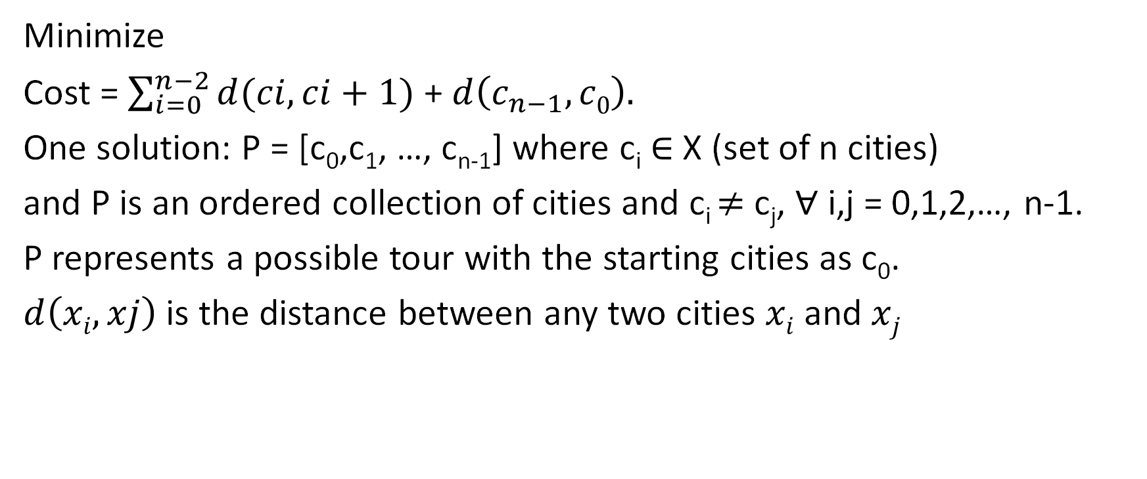
Defining the TSP
Minimize
Cost = $\sum_{i=0}^{n−2}{d(ci,ci+1)}$ + $d\left(c_{n−1},c0\right).$
One solution: P = [c₀,c₁, …, c_{n-1}] where c_{i} $∈$ X (set of n cities)
and P is an ordered collection of cities and c_{i} $≠$ c_{j}, $∀$ i,j = 0,1,2,…, n-1.
P represents a possible tour with the starting cities as c₀.
$d\left(xi,xj\right)$ is the distance between any two cities $xi$ and $xj$

